Slide 1
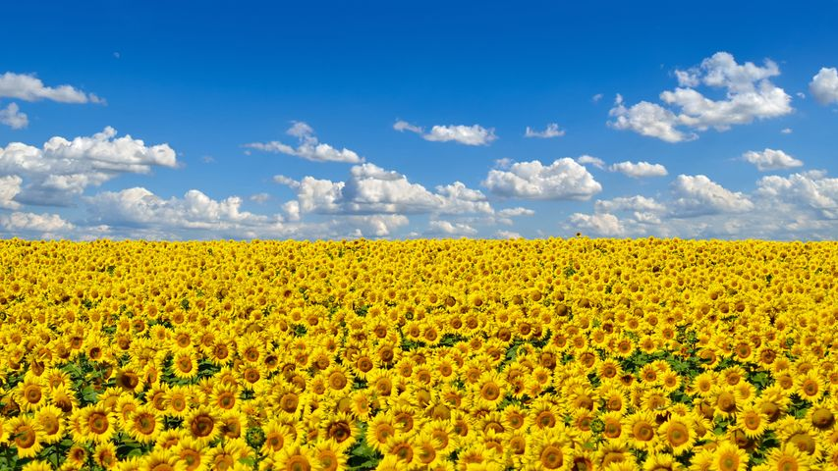

Ukrainian Children on the Move
Nataliia Pelypets, Icelandic Red Cross

Slide 2
5 questions about Ukrainian refugees
1. How many Ukraine war refugees have fled Ukraine since the start of Russian invasion?
2. How many Ukrainian children have been forced to flee the country?
3. Which countries are Ukrainian refugees fleeing to?
4. How many Ukraine war refugees arrived in Iceland?
5. How many Ukrainian refugees in Iceland are children?

Slide 3
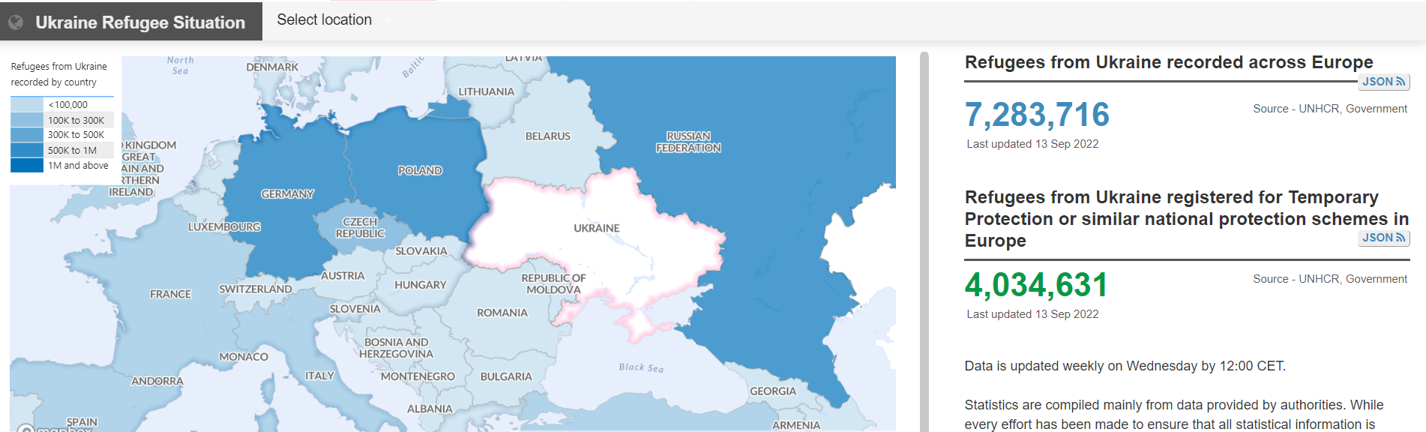
1. How many Ukraine war refugees have fled Ukraine since the start of Russian invasion?
As of September 13th, the total number of refugees fleeing Ukraine, reached over 7 million people

Slide 4
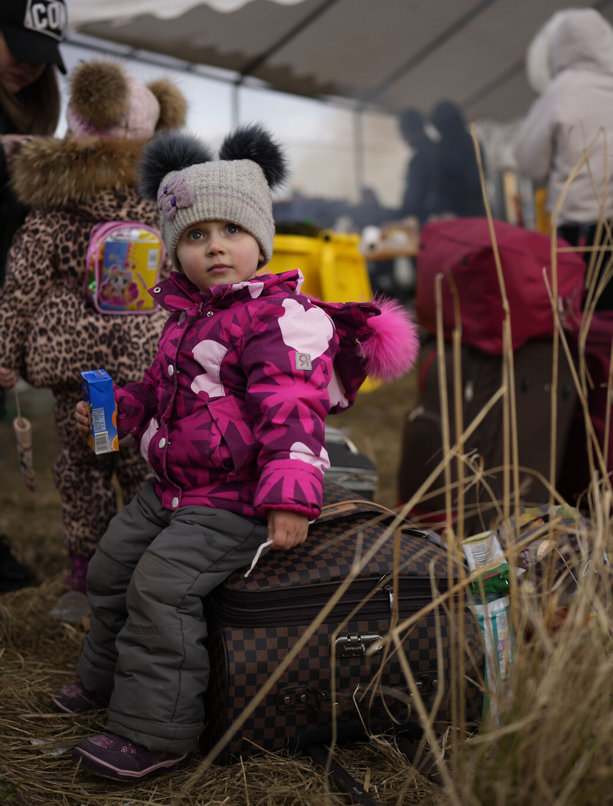
2. How many Ukrainian children have been forced to flee the country?
The war has forced two-thirds of children in Ukraine to flee their homes since the war started in February 2022.
More than 3 million children from Ukraine have become refugees.

Slide 5
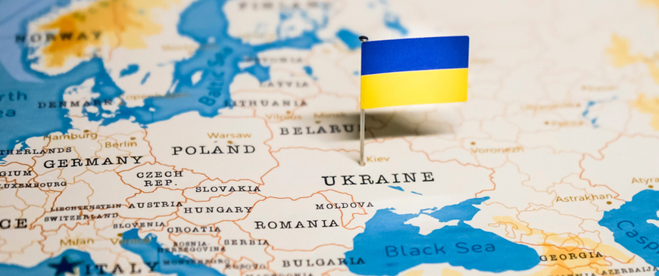
3. Which countries are Ukrainian refugees fleeing to?
Around 4 million refugees from Ukraine have fled to Poland. Other neighboring countries have also welcomed a large number of refugees following the war. Nearly 1 million Ukrainians have fled to Romania. Moldova has welcomed more than half a million Ukrainians, Hungary has taken in more than 800.000, and half a million Ukraine refugees have fled to Slovakia.

Slide 6
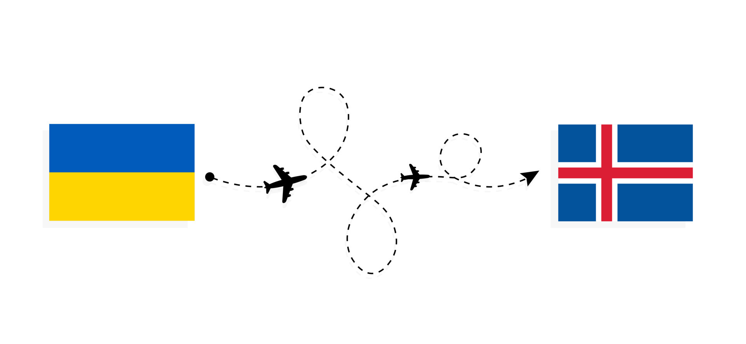
4. How many Ukraine War refugees have arrived in Iceland?
Iceland has welcomed over 1600 Ukrainian refugees according to the latest police report.

Slide 7
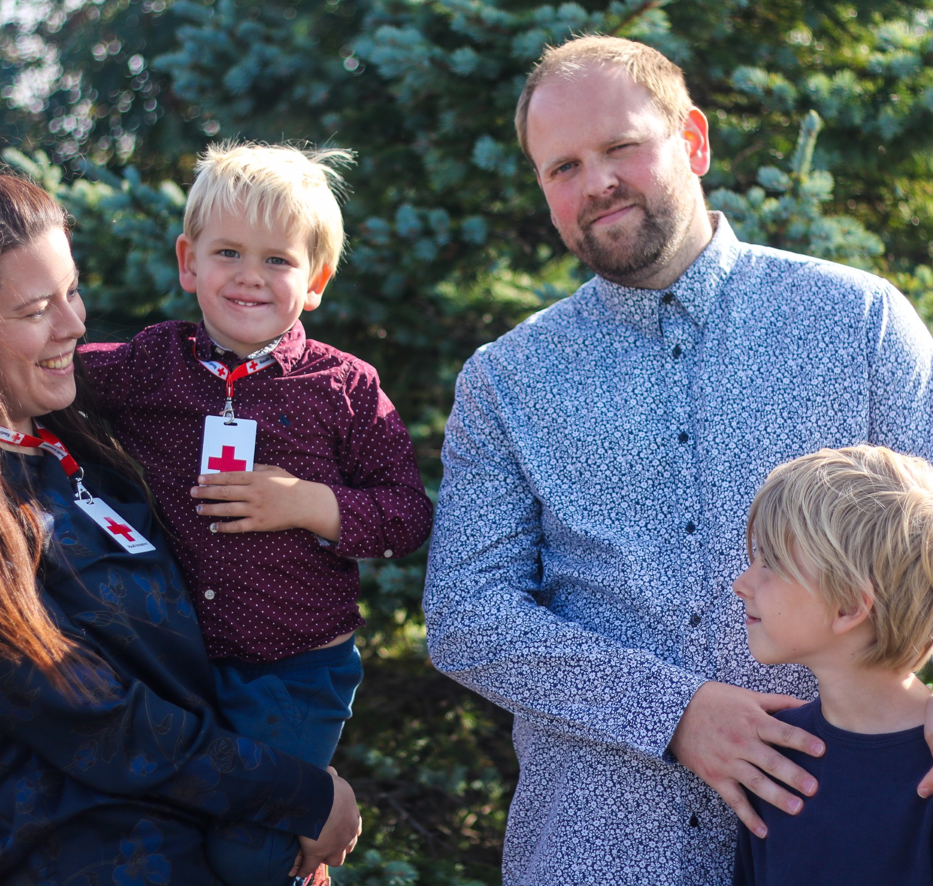
5. How many Ukrainian refugees in Iceland are children?
Around 400 those arriving from Ukraine are children under 18 y.o.

Slide 8
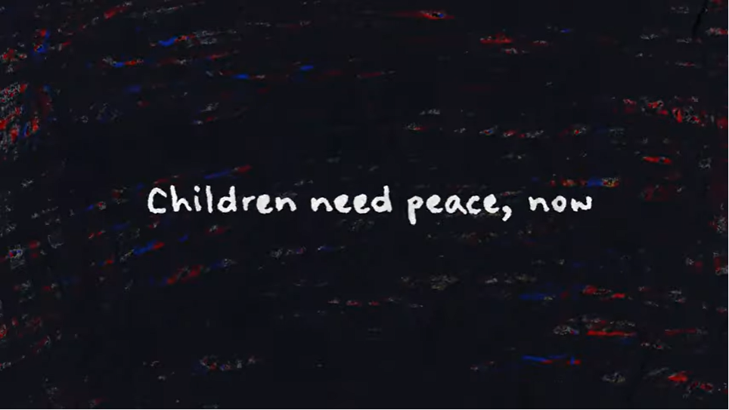
What other impact war has on children? (apart from displacement)
Real Child Drawings Show Brutality of War in Ukraine | UNICEF
https://youtu.be/rtKEML_AjW4

Slide 9




What other impact war has on children? (apart from displacement)
Life & Health
Other
Psychological impact
Future prospects
https://childrenofwar.gov.ua/en/
‘Lost generation’ of children
Education, hobbies, network
…

Slide 10
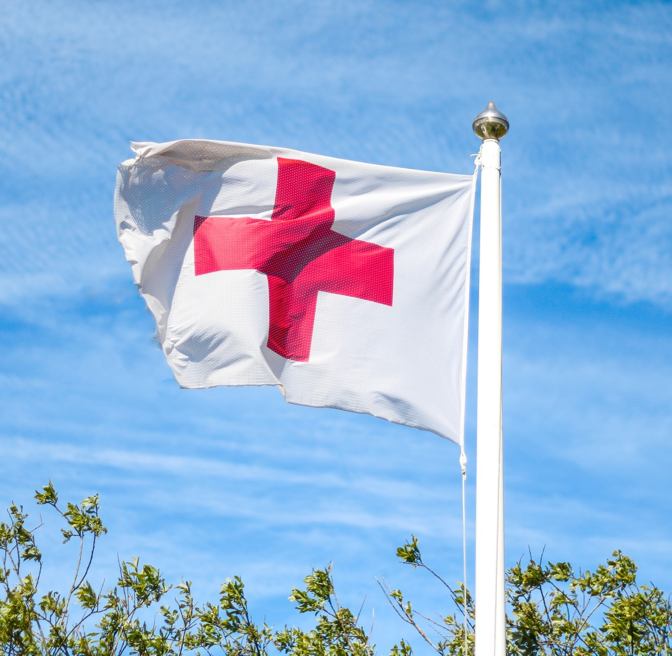
Thank you!

